Slide 1
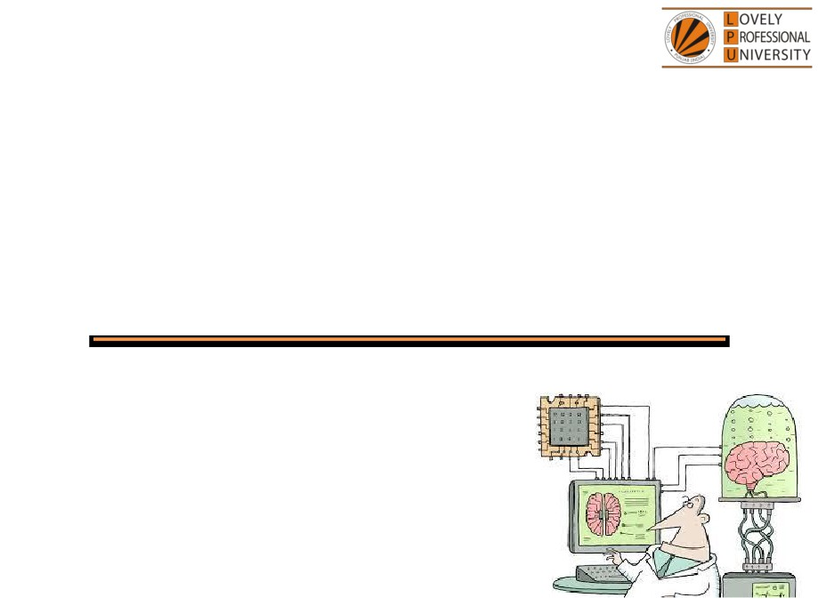
PEA308
Advanced Analytical Skills II
Lecture #0
Breaking the ice
Department of Analytical Skills

Slide 2

Course Details
LTP - 2 1 0 [Two lectures, One Tutorial per week]
Text Book
Quantitative Aptitude by Dr.R S Aggarwal
Reference Book
Quantitative Aptitude by M Tyra
Quantitative Aptitude by Abhijit Guha

Slide 3
Course Assessment Model
Marks break up
• Attendance
15
• CA
30
• MTE (MCQ)
15
• ETE (MCQ)
40
• Total
100
• MTE & ETE to be done on OMR sheets
All tests will be based on MCQ.

Slide 4

Course Outcomes
CO1 :: apply the concepts learned to solve the problems related to efficiency of the person.
CO2 :: demonstrate an appropriate approach for solution of time, speed and distance related problems.
CO3 :: employ the various logical reasoning techniques to reach at appropriate conclusions and solve the question related to logarithm and ranking.
CO4 :: use mathematical concepts learned to solve problems of mensuration, clocks and calendar.
CO5 :: apply the concepts of of trigonometry to solve height & distance based problems.
CO6 :: employ various fast calculation techniques for quick and accurate data interpretation.

Slide 5
Course focus identification
Employability

Slide 6
Assessment and Evaluation Model
Assessment (Category) | Conducted Week
CA 1 (A0303) | Week 5 (Duration 50 Min Q 30)
MTE (11A) | After week 7 (Duration 60 Minutes Q 40)
CA 2 (A0303) | Week 10 (Duration 50 Min Q 30)
CA 3 (A0303) | Week 14 (Duration 50 Min Q 30)
ETE (11A) | After week 14 (Duration 120 Min Q 80)

Slide 7
Innovative evaluation strategies
Evaluation | Conduct
CA 1 | External
MTE | External
CA 2 | External
CA 3 | External
ETE | External

Slide 8
Unit wise course content
Unit I
Efficiency : efficiency based problems, wages based problems, chain rule, alternate work problems, advanced time and work problems
Inlet -Outlet Pipes : inlet-outlet, part of the tank filled, time-based problems
Unit II
Time, speed and distance : concept of time, speed and distance, conversion of units and proportionality, average speed concept, advanced time and speed based questions, ratio based problems, races
Relative speed : relative speed concept, application based questions on relative speed
Objects on moving body : downstream and upstream, two variable problems
Unit III
Syllogism : logical venn diagrams, possibility based problems
Time sequence and Ranking test : number test, ranking test, time sequence test
Logarithm : basic concepts of the logarithm

Slide 9
Unit IV
Calendar : basic concept of calendar, date and days, finding the exact day, advanced concept of calendar
Clocks : concept of clock, gain and loss of time, angle based problems
Surface area and volume : perimeter and area of 2-D figures, problems on surface area and volume of cube and cuboid, problems on surface area and the volume of sphere and hemisphere, problems on surface area and volume of cone and cylinder
Unit V
Applications of trigonometry : problem based on height and distance, moving object based Seating arrangements : linear seating arrangement, circular seating arrangement
Coded inequalities : basic concepts of inequalities, comparison of roots of equation
Unit VI
Data interpretation : bar graph-based problems, tabular based problems, pie-chart based problems, linegraph based problems, mixed graph-based problems, histogram based problems Data sufficiency : check sufficiency of data

Slide 10


Let us look around…
Why every organization takes Quantitative Aptitude Tests before hiring any future employee…

Slide 11
Right Decision Making
Mental Alertness
Ability to quickly interpret data
Establish logical relationship
Arrive at the correct conclusions
Make the right judgment

Slide 12
Organizations recruit people who have
Quick Mental Abilities.
PEA502 Analytical Skills-II :: Vishal Ahuja

Slide 13
How you will make your mental ability Quick…!!!
Quick = Tricks
PEA502 Analytical Skills-II :: Vishal Ahuja

Slide 14
In climbing a 21 metre long round pole, a monkey climbs 6 metres in the first minute and slips 3 metres in the next minute. How many minutes would the monkey take to reach the top of the pole?

Slide 15
And What about this….?
There is a tank with two taps. One tap empties the tank in 6 minutes and the other one empties the tank in 3 minutes. If both were open, how long would it take to empty the tank?

Slide 16

5 minute…???
10 minutes…???
15 minutes…???
20 minutes…???
Again…!!! It will not take more than 30 SECONDS.

Slide 17
What do we need to know?
This course PEA308 : Advanced Analytical Skills-II
Ability to efficiently solve the company specific Quantitative
Aptitude Tests.
Ability to prioritize and manage Time.
Ability to efficiently analyze data.

Slide 18


Slide 19


Next Class: Efficiency

